Slide 1
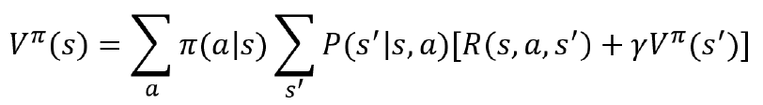
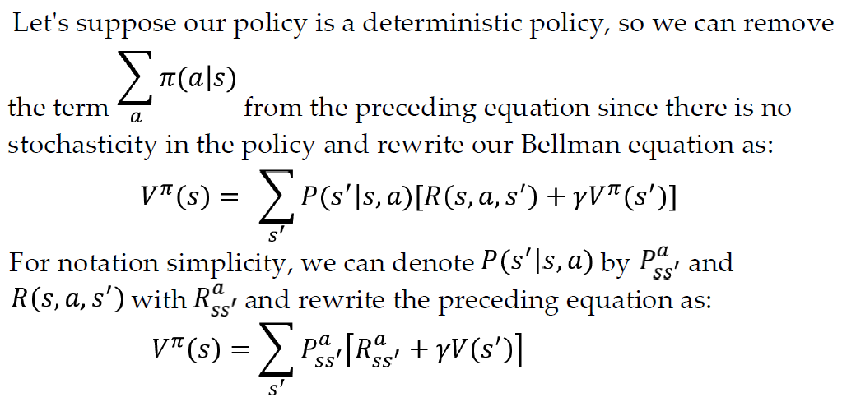
Policy Iteration
In policy iteration we try to compute the optimal value function using the policy iteratively, once we found the optimal value function, we can use it to extract the optimal policy.
How to compute the value function using a policy??
According to the Bellman equation, we can compute the value function using the policy.
We will not be given any policy as an input. So, we will initialize the random policy and compute the value function using the random policy. Then we check if the computed value function is optimal or not. It will not be optimal since it is computed based on the random policy.
So, we will extract a new policy from the computed value function, then we will use the extracted new policy to compute the new value function, and then we will check if the new value function is optimal. If it's optimal we will stop, else we repeat these steps for a series of iterations.

Slide 2
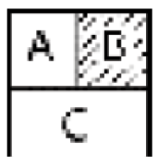
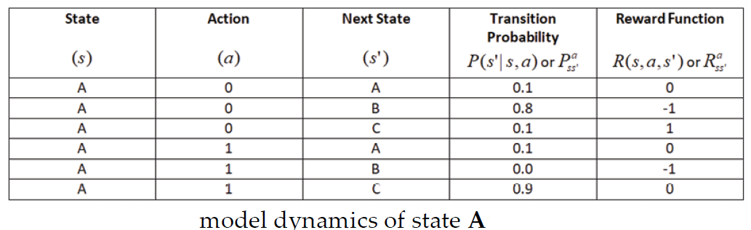
Policy Iteration algorithm with example:
The steps of the policy iteration algorithm is given as follows:
1. Initialize a random policy
2. Compute the value function using the given policy
3. Extract a new policy using the value function obtained from step 2
4. If the extracted policy is the same as the policy used in step 2, then stop, else send the extracted new policy to step 2 and repeat steps 2 to 4
Let's say we are in state A and our goal is to reach state C without visiting the shaded state B, and say we have two actions,
0 — left/right, and 1 — up/down.
The optimal policy here is the one that tells us to perform action 1 in state A so that we can reach C without visiting B.

Slide 3

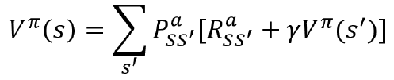
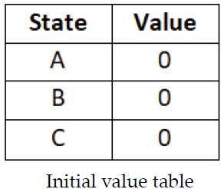
Step 1 – Initialize a random policy
First, we will initialize a random policy. As the following shows, our random policy tells us to perform action 1 in state A, 0 in state B, and action 1 in state C:
Step 2 – Compute the value function using the given policy
In policy iteration, we compute the value function using a policy , unlike value iteration, where we computed the value function using the maximum over the Q function. The value function using a policy can be computed as:
The values of the transition probability and the reward function can be obtained from the model dynamics. But what about the value of the next state ? We don't know the value of any states yet. So, we will initialize the value function (state values) with random values or zeros and compute the value function.

Slide 4
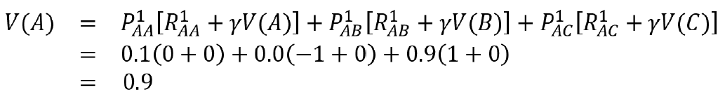
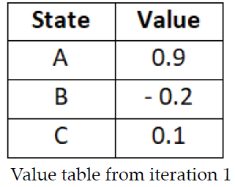
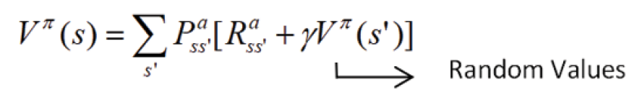
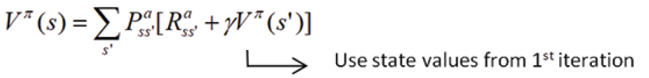
Iteration 1:
Let's compute the value of state A (note that here, we only compute the value for the action given by the policy, unlike in value iteration, where we computed the Q value for all the actions in the state and selected the maximum value).
The action given by the policy for state A is 1 and we can compute the value of state A as the following shows (note that we have used a discount factor as 1 throughout this section):
Similarly, we compute the value for all the states using the action given by the policy.
The value function will not be accurate because when we started off computing the value function using the given policy, we used the randomly initialized state values
So, in the next iteration, while computing the value function, we will use the updated state values obtained as a result of the first iteration:

Slide 5
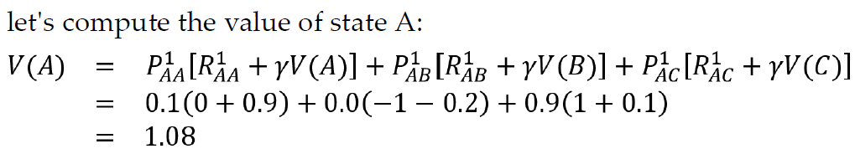
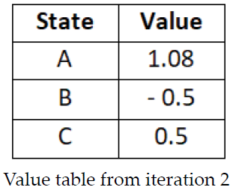
Iteration 2:
Note that unlike the value iteration method, here we are not checking whether our value function is optimal or not; we just check whether our value function is accurately computed according to the given policy.
Now, in iteration 2, we compute the value function using the policy . Remember that while computing the value function, we will use the updated state values (value table) obtained from iteration 1.
Similarly, we compute the value for all the states using the action given by the policy. Table shows the updated state values obtained as a result of the second iteration:

Slide 6
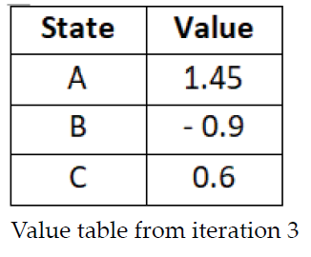
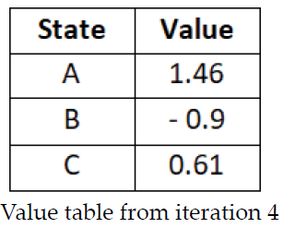
Similarly, in iteration 3, we compute the value function using the policy and while computing the value function, we will use the updated state values (value table) obtained from iteration 2.
We repeat this for many iterations until the value table does not change or changes very little over iterations.For example, let's suppose Table 3.19 shows the value table obtained as a result of iteration 4:
As we can see, the difference between the value tables obtained from iteration 4 and iteration 3 is very small. So, we can say that the value table is not changing much over iterations and we stop at this iteration and take this as our final value function.

Slide 7
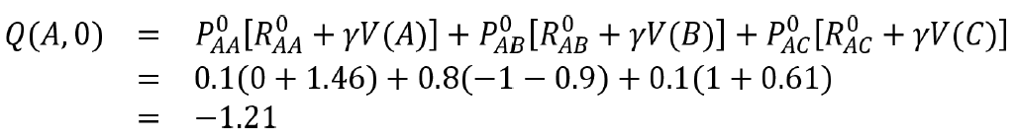
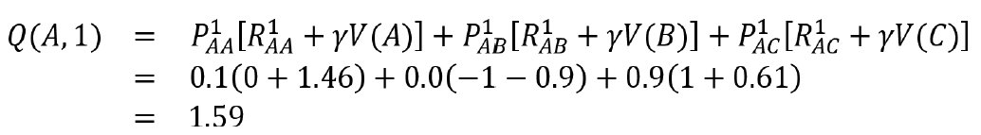
Step 3 – Extract a new policy using the value function obtained from the previous step:
we obtained the value function, which is computed using the given random policy. However, this value function will not be optimal as it is computed using the random policy. So will extract a new policy from the value function obtained in the previous step.
how can we extract a new policy from the value function?
In order to extract a new policy, we compute the Q function using the value function (value table) obtained from the previous step.
let's compute the Q value for all actions in state A using the value function obtained from the previous step. The Q value for action 0 in state A is computed as:
The Q value for action 1 in state A is computed as

Slide 8
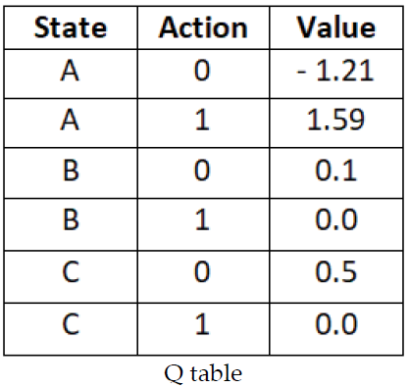
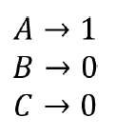
Q table after computing the Q values for all state-action pairs:
From this Q table, we pick up actions in each state that have the maximum value as a new policy.
Step 4 – Check the new policy
Now we will check if the extracted new policy from step 3 is the same as the policy we used in step 2. If it is the same, then we stop, else we send the extracted new policy to step 2 and repeat steps 2 to 4. Thus, this is how to compute the optimal policy using the policy iteration method.

Slide 9
Limitation of Dynamic Programming
In Dynamic Programming, in order to find the optimal policy, we compute the value function and Q function. But to compute the value and the Q function, we need to know the transition probability of the environment, and when we don't know the transition probability of the environment, we cannot compute the value and the Q function in order to find the optimal policy.
That is, dynamic programming is a model-based method and to apply this method, we need to know the model dynamics (transition probability) of the environment, and when we don't know the model dynamics, we cannot apply the dynamic programming method.
how can we find the optimal policy when we don't know the model dynamics of the environment? In such a case, we can use model-free methods such as Monte Carlo.

